Slide 1
Instance Based Learning (KNN Classifier)
Course Title: Machine Learning
Dept. of Computer Science
Faculty of Science and Technology
Lecturer No: |  | Week No: |  | Semester:
Lecturer: | Sharfuddin Mahmood (smahmood@aiub.edu)

Slide 2
Instance-Based Learning
Idea:
Similar examples have similar label.
Classify new examples like similar training examples.
Algorithm:
Given some new example x for which we need to predict its class y
Find most similar training examples
Classify x “like” these most similar examples
Questions:
How to determine similarity?

Slide 3
Instance-Based Classifiers
Examples:
Rote-learner
• Memorizes entire training data and performs classification only if attributes of record match one of the training examples exactly
Nearest neighbor
• Uses k “closest” points (nearest neighbors) for performing classification

Slide 4
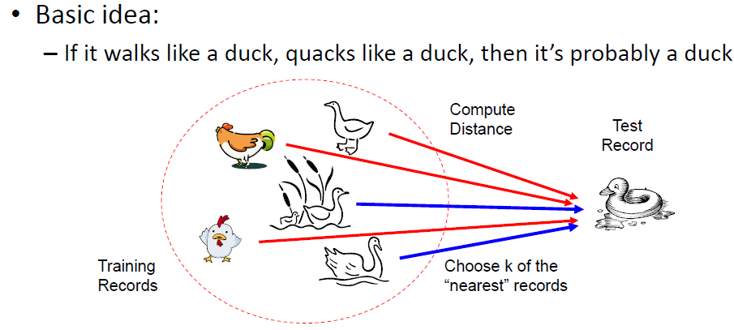
Nearest Neighbor Classifiers

Slide 5
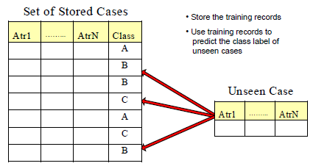
Instance-Based Classifiers

Slide 6
1-Nearest Neighbor
One of the simplest of all machine learning classifiers
Simple idea: label a new point the same as the closest known point
Label it red.

Slide 7
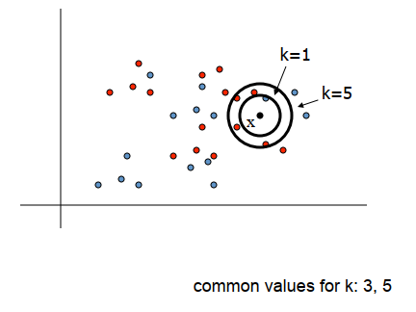
K-­Nearest Neighbor Methods
To classify a new input vector x, examine the k‐closest training data points to x and assign the object to the most frequently occurring class

Slide 8
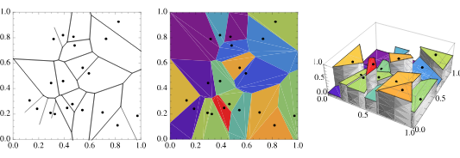
Decision Boundaries
The nearest neighbor algorithm does not explicitly compute decision boundaries. However, the decision boundaries form a subset of the Voronoi diagram for the training data.
The more examples that are stored, the more complex the decision boundaries can become

Slide 9
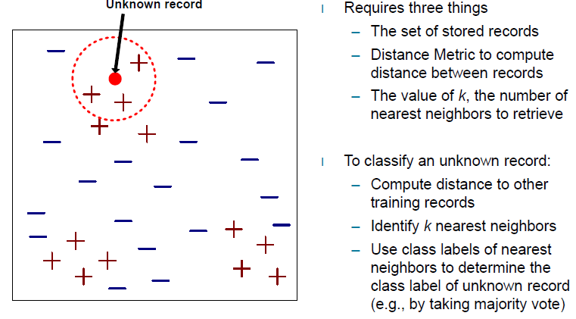
Nearest-Neighbor Classifiers
K = 3

Slide 10
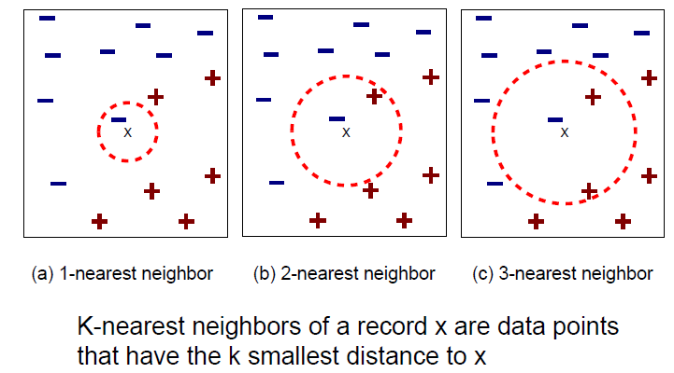
Definition of Nearest Neighbor

Slide 11
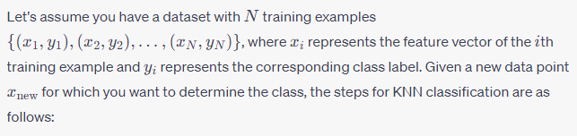
Steps to determine a class using KNN

Slide 12
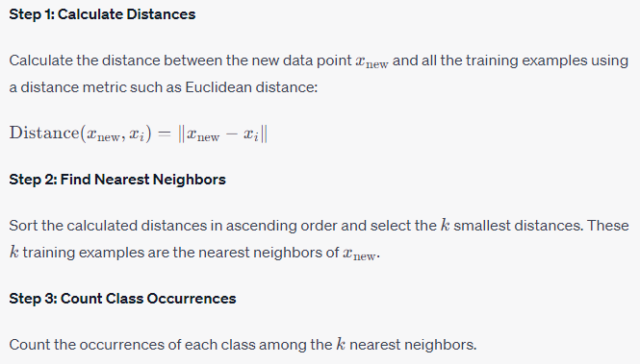
Steps to determine a class using KNN

Slide 13
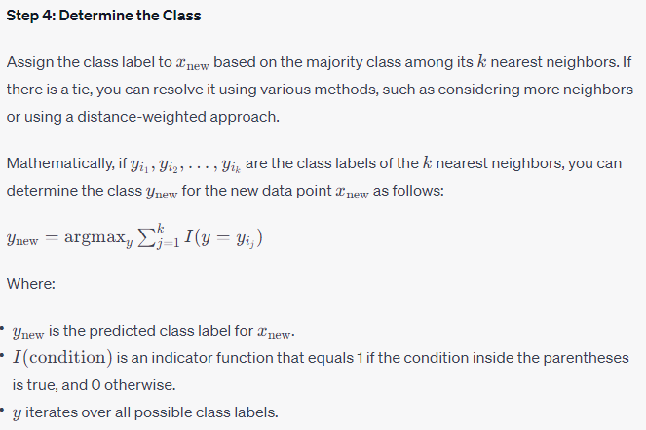
Steps to determine a class using KNN

Slide 14
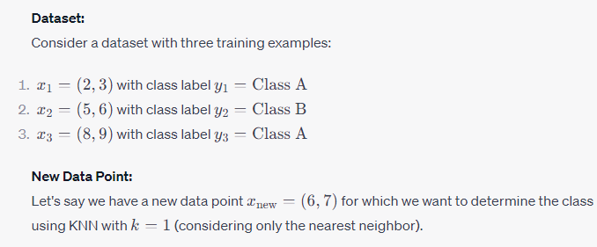
Example

Slide 15
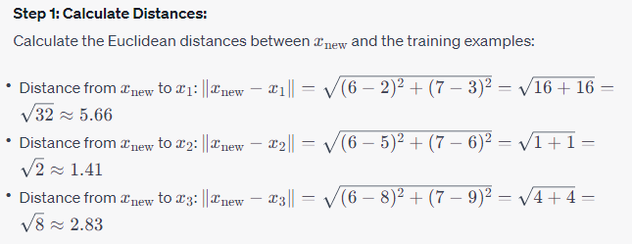
Example

Slide 16
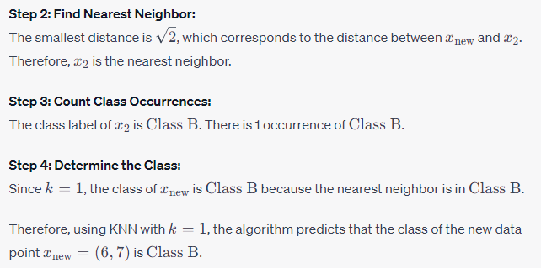
Example

Slide 17
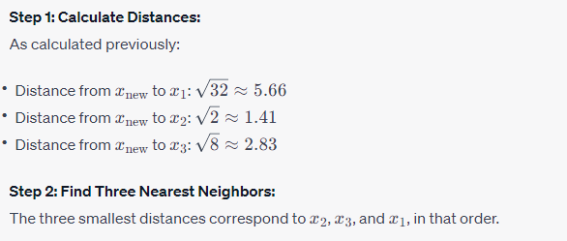
Example
What about K=3?

Slide 18
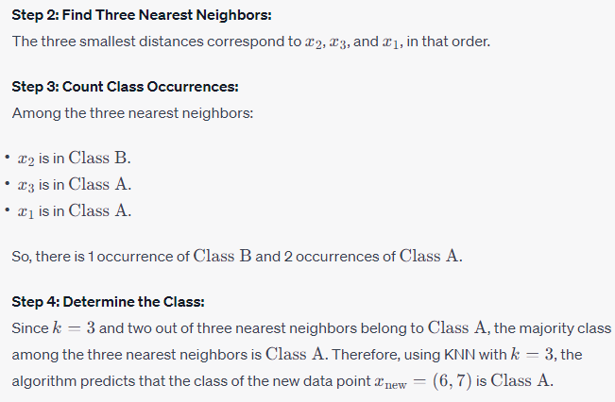
Example

Slide 19
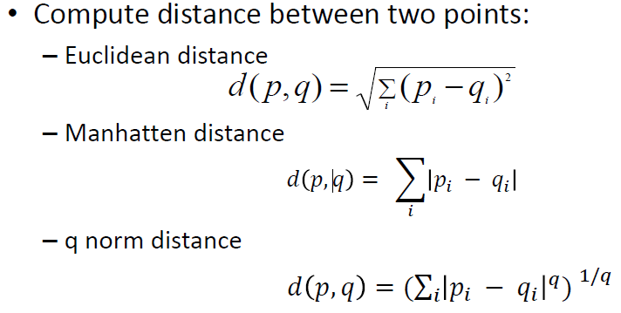
Nearest Neighbor Classification

Slide 20
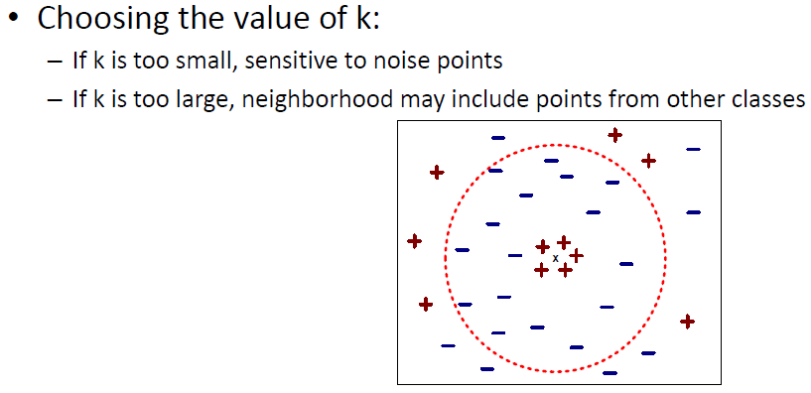
Nearest Neighbor Classification…

Slide 21
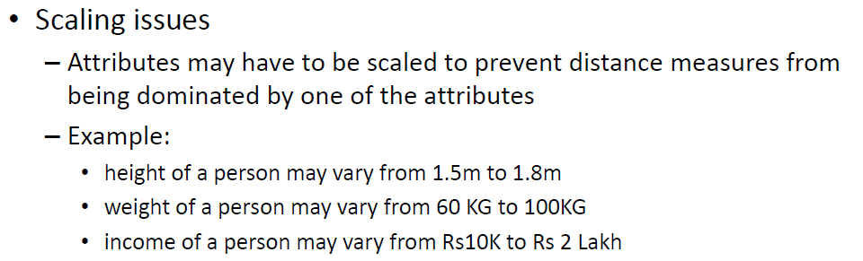
Nearest Neighbor Classification…

Slide 22
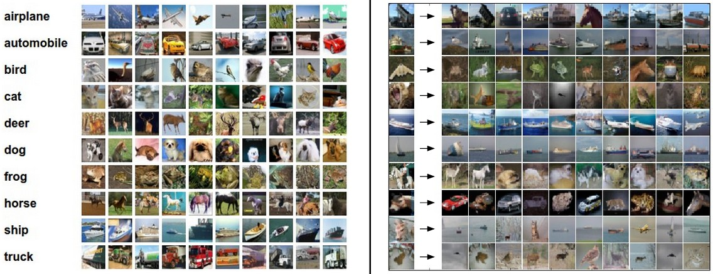
Example dataset: CIFAR-10
10 labels
50,000 training images, each image is tiny: 32x32
10,000 test images.

Slide 23
Example dataset: CIFAR-10
10 labels
50,000 training images
10,000 test images.
For every test image (first column), examples of nearest neighbors in rows

Slide 24


The choice of distance is a hyperparameter common choices:
L1 (Manhattan) distance
L2 (Euclidean) distance

Slide 25
Bias and Variance
The bias is an error from erroneous assumptions in the learning algorithm. High bias can cause an algorithm to miss the relevant relations between features and target outputs.
The variance is an error from sensitivity to small fluctuations in the training set. High variance can cause an algorithm to model the random noise in the training data, rather than the intended outputs.

Slide 26
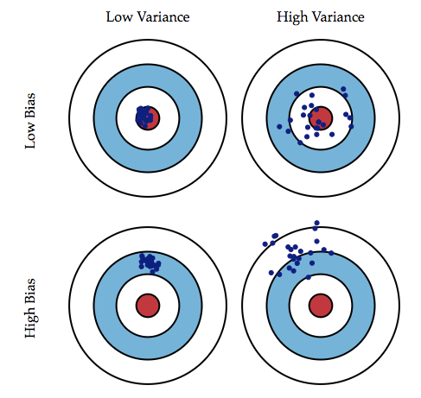

Slide 27
Bias and Variance
Increasing k in the kNN algorithm should have what effect on:
Bias: ?
Variance: ?

Slide 28
Bias and Variance
Increasing k in the kNN algorithm should have what effect on:
Bias: Should increase. The large k is, the further (on average) are the points being aggregated from x
Variance: ?

Slide 29
Bias and Variance
Increasing k in the kNN algorithm should have what effect on:
Bias: Should increase. The large k is, the further (on average) are the points being aggregated from x. i.e. the value depends on f(x’) for x’ further from x.
Variance: Should decrease. The average or majority vote of a set of equal-variance values has lower variance than each value.

Slide 30
Bias and Variance Rule of Thumb
Compared to simpler (fewer parameters), complex models have what kind of Bias and Variance?:
Bias: ?
Variance:?

Slide 31
Bias and Variance Rule of Thumb
Compared to simpler (fewer parameters), complex models have what kind of Bias and Variance?:
Bias: ? Lower, because complex models can better model local variation in f(x).
Variance:?

Slide 32
Bias and Variance Rule of Thumb
Compared to simpler (fewer parameters), complex models have what kind of Bias and Variance?:
Bias: ? Lower, because complex models can better model local variation in f(x).
Variance:? Higher, because the parameters are generally more sensitive to few data values.

Slide 33
Bias and Variance Rule of Thumb
Compared to simpler (fewer parameters), complex models have what kind of Bias and Variance?:
Bias: ? Lower, because complex models can better model local variation in f(x).
Variance:? Higher, because the parameters are generally more sensitive to few data values.
Complex models are prone to overfitting. They require/benefit from large training datasets in order to reduce variance. This includes most Deep Networks.

Slide 34
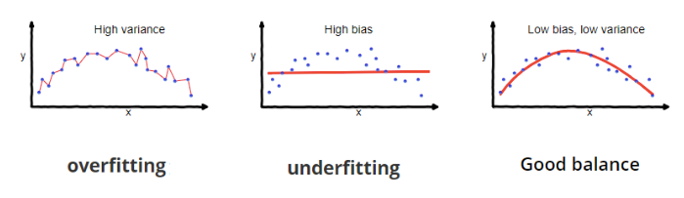

Slide 35
Hyperparameter tuning:
What is the best distance to use?
What is the best value of k to use?
i.e. how do we set the hyperparameters?
Very problem-dependent.
Must try them all out and see what works best.

Slide 36
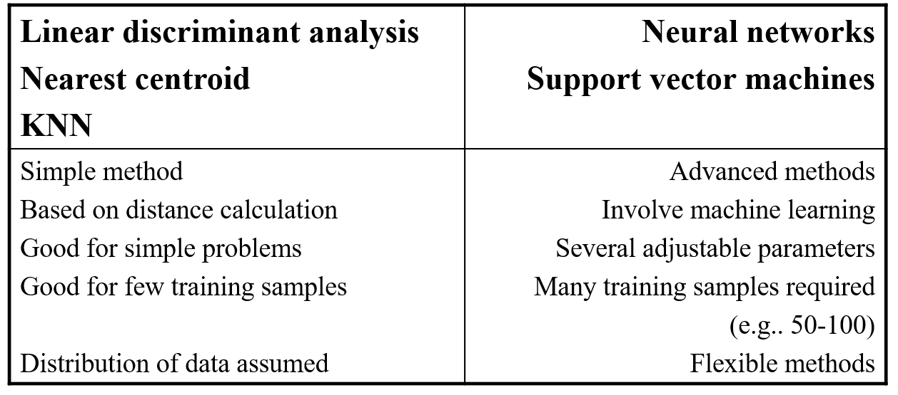
Comparison of Methods

Slide 37
KNN Advantages
Easy to program
No optimization or training required
Classification accuracy can be very good; can outperform more complex models

